Slide 1
Binary Logistic Regression
Modeling Binary Dependent Variable

Slide 2
Contents
01
02
Binary Logistic Regression Intro
Why Not Use Linear Regression for Binary Target
03
04
Modeling Customer Default(0/1)
Estimation of Parameters
05
06
ROC Curve and Confusion Matrix
Predicted Values

Slide 3



Binary Logistic Regression
Binary logistic regression is the statistical method of choice when your dependent variable is binary—taking only two possible values such as zero or one, yes or no, presence or absence, or survival or death. This powerful technique allows you to model the probability of an event occurring based on one or more predictor variables.
Marketing Analytics
Churn Management
Risk Management
Cross-sell and up-sell prediction models
Customer and employee retention analysis
Credit scoring and fraud detection systems
The independent variables in your model can be either categorical (such as gender or region) or continuous (such as age or income), providing tremendous flexibility in model specification. This versatility makes logistic regression applicable across diverse fields including market research and clinical studies.

Slide 4
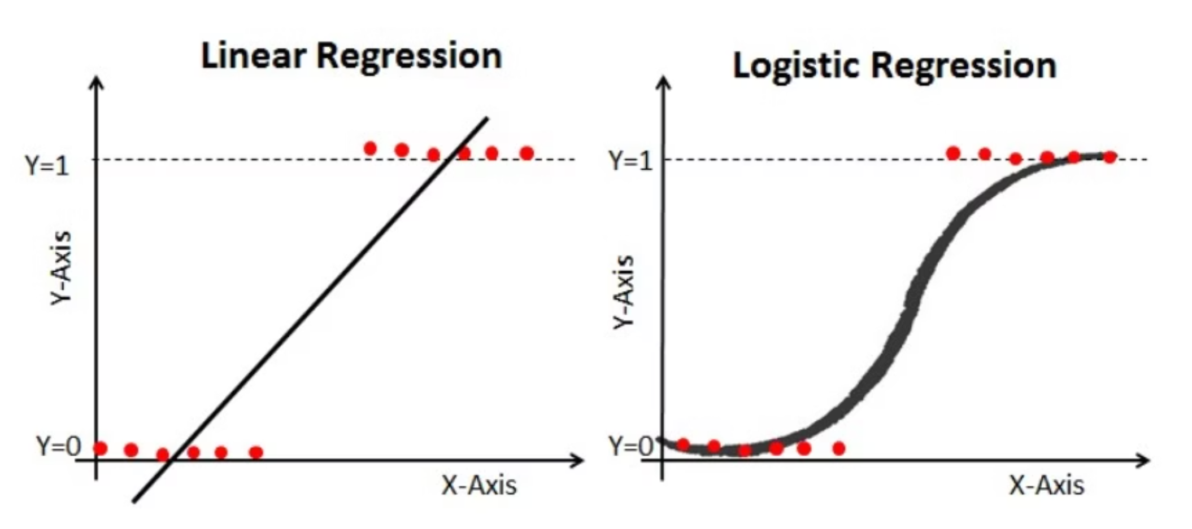
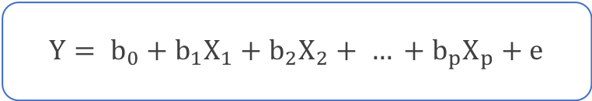
Why Not Use Linear Regression Model?
The statistical model for multiple linear regression is
$$Y= b_{0}+b_{1}X_{1}+b_{2}X_{2}+ … +b_{p}X_{p}+e$$
If binary variable Y is used on left hand side of the model, then the two sides are not comparable. Right hand side is a continuous term.
If probability ‘P’ is used instead of Y then linearity may not hold true. The relationship assumed in logistic regression is a ‘S’ shaped curve.

Slide 5
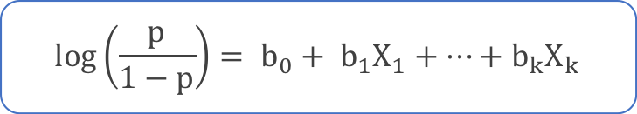
The Statistical Model
The mathematical foundation of binary logistic regression transforms the bounded probability into an unbounded scale that can be modeled linearly. This transformation is the key to the method's success.
Let Y be the binary dependent variable and X₁, X₂, ..., Xₖ be K independent variables. We define p as the probability that Y equals 1. The logistic regression model is:
$$log\left(\frac{p}{1−p}\right)= b_{0}+ b_{1}X_{1}+…+b_{k}X_{k}$$
The parameters b₀, b₁, ..., bₖ are estimated using Maximum Likelihood Estimation (MLE), which finds the parameter values that make the observed data most probable.

Slide 6



Understanding the Transformation
The logistic transformation involves three key steps, each expanding the range of possible values to enable linear modeling.
Step 1: Probability
Step 2: Odds
Step 3: Log-Odds
p lies between 0 and 1, representing the probability of the outcome occurring.
p/(1-p) lies between 0 and infinity, expressing probability as odds rather than proportion.
log[p/(1-p)] lies between -∞ and +∞, creating an unbounded scale suitable for linear modeling.
This elegant transformation allows us to model binary outcomes using the familiar linear equation framework while respecting the bounded nature of probabilities. The model cannot directly use Y (which is only 0 or 1) on the left-hand side, so we work with the log-odds instead.

Slide 7
Case Study: Predicting Loan Defaulters
Predict whether a customer applying for a loan will default on repayment, allowing the bank to make informed lending decisions and manage risk effectively
Dependent Variable: Defaulter: Binary variable coded as 1 if the customer defaulted after receiving the loan, 0 otherwise. This status is observed after loan disbursement.
DEFAULTER
(YES OR NO)
AGE
EMPLOY
(-)
ADDRESS
(-)
DEBTINC
(+)
OTHDEBT
(+)
CREDDEBT
(+)
Independent Variables(All predictor information was collected during the loan application process,
Age group (categorical)
Years at current address
Years with current employer
Debt-to-income ratio
Credit card debt amount
Other debt obligations

Slide 8
Sample Data Structure
Understanding the data structure is essential before building any statistical model. Here's a representative sample of the loan default dataset showing the first few observations.
AGE
EMPLOY
ADDRESS
DEBTINC
CREDDEBT
OTHDEBT
DEFAULTER
3
17
12
9.30
11.36
5.01
1
1
10
6
17.30
1.36
4.00
0
2
15
14
5.50
0.86
2.17
0
3
15
14
2.90
2.66
0.82
0
1
2
0
17.30
1.79
3.06
1
3
5
5
10.20
0.39
2.16
0
Note: Age groups are coded as 1 (under 28 years), 2 (28-40 years), and 3 (over 40 years). EMPLOY and ADDRESS represent years in each category. DEBTINC is the debt-to-income ratio expressed as a percentage.

Slide 9
Testing Individual Predictors: Wald's Test
After estimating the model parameters, we need to determine which predictors significantly influence the outcome. Wald's test provides this assessment for each individual coefficient.
Hypothesis Structure
Test Statistic
Null Hypothesis (H₀): bᵢ = 0
The predictor has no effect on the outcome.
Alternative Hypothesis (H₁): bᵢ ≠ 0
Under the null hypothesis, Z follows a standard normal distribution. Some software packages (like SAS) report the Wald chi-square statistic, which is simply Z² and follows a chi-square distribution with 1 degree of freedom.
The predictor significantly influences the outcome.
The test applies to each predictor separately, where i = 1, 2, 3, ..., k.
Decision Rule: Reject H₀ if the p-value < 0.05 (using standard significance level).

Slide 10
Initial Model Results
The first model included all predictor variables. Here are the coefficient estimates with their statistical significance tests.
Variable
Estimate
Std. Error
Z value
P-value
Significance
(Intercept)
-0.78821
0.26407
-2.985
0.00284
**
AGE2
0.25202
0.26651
0.946
0.34433
AGE3
0.62707
0.36056
1.739
0.08201
.
EMPLOY
-0.26172
0.03188
-8.211
< 0.0001
***
ADDRESS
-0.09964
0.02234
-4.459
< 0.0001
***
DEBTINC
0.08506
0.02212
3.845
0.00012
***
CREDDEBT
0.56336
0.08877
6.347
< 0.0001
***
OTHDEBT
0.02315
0.05709
0.405
0.68517
Key Finding: EMPLOY, ADDRESS, DEBTINC, and CREDDEBT are statistically significant predictors. AGE and OTHDEBT show no significant relationship with default probability and should be removed from the model.

Slide 11
Refined Model Results
After removing the non-significant predictors (AGE and OTHDEBT), we re-estimated the model with only the meaningful variables. This refined model is more parsimonious and easier to interpret.
Variable
Estimate
Std. Error
Z value
P-value
Significance
(Intercept)
-0.79107
0.25154
-3.145
0.00166
**
EMPLOY
-0.24258
0.02806
-8.646
< 0.0001
***
ADDRESS
-0.08122
0.01960
-4.144
< 0.0001
***
DEBTINC
0.08827
0.01854
4.760
< 0.0001
***
CREDDEBT
0.57290
0.08725
6.566
< 0.0001
***
Interpretation: All four remaining predictors are highly significant. Negative coefficients (EMPLOY, ADDRESS) indicate that longer employment tenure and residence stability reduce default probability. Positive coefficients (DEBTINC, CREDDEBT) show that higher debt levels increase default risk.

Slide 12
Predicting Probabilities
Once the model is estimated, we can calculate predicted default probabilities for each observation in our dataset. These probabilities guide lending decisions.
ID
EMPLOY
ADDRESS
DEBTINC
CREDDEBT
DEFAULTER
Pred. Prob
1
17
12
9.3
11.36
1
0.81
2
10
6
17.3
1.36
0
0.20
3
15
14
5.5
0.86
0
0.01
4
15
14
2.9
2.66
0
0.02
5
2
0
17.3
1.79
1
0.78
6
5
5
10.2
0.39
0
0.22
To make binary predictions, we need a cut-off value. For example, if we set the cut-off at 0.5, any predicted probability above 0.5 is classified as Y = 1 (defaulter), while probabilities at or below 0.5 are classified as Y = 0 (non-defaulter). The choice of cut-off significantly impacts model performance.

Slide 13
The Classification Table
A classification table, also called a confusion matrix, compares actual outcomes with predicted classifications. This cross-tabulation reveals how well the model performs.
Classification at 0.5 Cut-off
Understanding the Table
Actual
Pred: 0
Pred: 1
Top-left (479): True negatives—correctly identified non-defaulters
0 (Non-defaulter)
479
38
Bottom-right (92): True positives—correctly identified defaulters
Top-right (38): False positives—non-defaulters wrongly classified as defaulters
1 (Defaulter)
91
92
Bottom-left (91): False negatives—defaulters wrongly classified as non-defaulters
Misclassification Rate: (38 + 91) / 700 = 18.43%
The model correctly classifies 81.57% of cases when using a 0.5 probability cut-off.
The classification table varies with the chosen cut-off value, so it should not be used as the sole measure of model quality. Different cut-offs produce different trade-offs between types of errors.

Slide 14
Key Performance Metrics
Understanding classification performance requires specific terminology that captures different aspects of prediction accuracy.
Sensitivity
Specificity
The percentage of actual occurrences correctly predicted: P(Ypred=1 | Y=1)
The percentage of actual non-occurrences correctly predicted: P(Ypred=0 | Y=0)
Also called the true positive rate. Measures how well the model identifies positive cases.
Also called the true negative rate. Measures how well the model identifies negative cases.
False Positive Rate
False Negative Rate
Calculated as (1 - Specificity). The percentage of non-occurrences incorrectly predicted as occurrences: P(Ypred=1 | Y=0)
Calculated as (1 - Sensitivity). The percentage of occurrences incorrectly predicted as non-occurrences: P(Ypred=0 | Y=1)
Represents Type II error in hypothesis testing.
Represents Type I error in hypothesis testing.

Slide 15
Cut-off Analysis: Finding the Balance
Model performance varies dramatically depending on the probability cut-off chosen for classification. Examining multiple cut-offs reveals important trade-offs.
Cut-off Value
Sensitivity
Specificity
Interpretation
0.1
93.4%
48.7%
Catches most defaulters but many false alarms
0.2
84.7%
68.1%
Better balance emerging
0.3
74.9%
80.3%
Optimal balance point
0.4
61.7%
86.8%
High specificity but missing defaulters
0.5
50.3%
92.6%
Very conservative, misses many defaulters
Recommendation: The optimal cut-off of 0.3 achieves balanced sensitivity (74.9%) and specificity (80.3%). This balance depends on business context—in lending, false negatives (missed defaulters) may be costlier than false positives (rejected good customers), suggesting a lower cut-off might be preferable.

Slide 16
ROC Curve: Visualizing Performance
The Receiver Operating Characteristic (ROC) curve provides a comprehensive graphical representation of model performance across all possible cut-off values simultaneously.
Understanding the ROC Curve
Area Under the Curve (AUC)
The ROC curve plots sensitivity (true positive rate) on the Y-axis against 1-specificity (false positive rate) on the X-axis for every possible cut-off value.
AUC = 0.8558
The area under the ROC curve (C-statistic) quantifies overall model discrimination ability:
Each point on the curve represents the sensitivity-specificity trade-off at a particular cut-off. Moving up and right along the curve means accepting more false positives to capture more true positives.
C = 1.0: Perfect model
C = 0.8558: Good model
C = 0.7-0.8: Acceptable
The diagonal line from (0,0) to (1,1) represents random guessing—a worthless model. Good models bow toward the top-left corner, maximizing sensitivity while minimizing false positives.
C = 0.5: No better than chance
Our model's AUC of 0.8558 indicates strong predictive ability for distinguishing defaulters from non-defaulters.

Slide 17
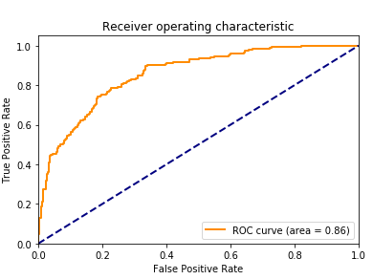
ROC Curve: Visualizing Performance
The Receiver Operating Characteristic (ROC) curve provides a comprehensive graphical representation of model performance across all possible cut-off values simultaneously.
Area Under the Curve (AUC)
AUC = 0.8558
The area under the ROC curve (C-statistic) quantifies overall model discrimination ability:
Our model's AUC of 0.8558 indicates strong predictive ability for distinguishing defaulters from non-defaulters.

Slide 18
The Multicollinearity Problem
Multicollinearity occurs when there is a strong linear relation among independent variables.
Why It Matters
Detection Method
Strong linear relationships among predictors cause several problems:
Inflated standard errors of coefficients
Unstable parameter estimates
Difficulty interpreting individual effects
Use Variance Inflation Factors (VIF) to detect multicollinearity. For each predictor Xᵢ:
Regress Xᵢ on all other predictors
Calculate R² from this regression
Compute VIF = 1/(1-R²)
These issues can lead to incorrect conclusions about which variables truly matter for prediction.
Decision Rule: Any VIF > 5 indicates problematic multicollinearity requiring attention through variable removal, combination, or transformation.

Slide 19
Key Takeaways
01
02
Choose logistic regression when your outcome is binary
The log-odds transformation is key
Linear regression fails with binary outcomes because it cannot constrain predictions between 0 and 1.
Converting bounded probabilities to unbounded log-odds enables linear modeling while preserving probability interpretation.
03
04
Use Wald's test for variable significance
Cut-off selection balances errors
Test each coefficient individually and remove non-significant predictors to create a parsimonious, interpretable model.
Different cut-offs yield different sensitivity-specificity trade-offs. Choose based on the relative costs of false positives versus false negatives in your context.
05
06
ROC curve measures overall performance
Always check for multicollinearity
The area under the ROC curve provides a single metric of model discrimination ability across all cut-offs. AUC above 0.8 indicates good predictive power.
Use VIF to detect correlated predictors. Values above 5 require attention to ensure stable, interpretable results.

